Slide 1


Sir M. Visvesvaraya Institute of Technology
Bengaluru- 562157
Project Work Phase-I (18ECP78)
AUTONOMOUS FEEDING ROBOT WITH ARDUINO
Names of the Student with USN
Ritika Mishra (1MV19EC095)
2. Sonal Jha (1MV19EC108)
3. Aman Kumar (1MV19EC010)
4. Malik lalji (1MV19EC065)
Under the Guidance of:
Dr. R Sundaraguru
Professor & HOD
Dept. of ECE
Department of Electronics and Communication Engineering
Notes:
© Copyright PresentationGO.com – The free PowerPoint and Google Slides template library

Slide 2
Contents
Introduction
Literature survey
Problem statement
Objectives
Methodologies
Hardware and software requirements
Expected Results
References

Slide 3
Introduction
Robotic arms - used for industry automation and operation in the hazardous environment.
Evaluated on the basis of backlash, payload, speed, repeatability, compliance, human safety, and cost.
Grasping and object manipulation, high repeatability and low backlash are important.
Arduino UNO A000066 is used as the brain of the robotic arm,
Force sensors are placed at the gripper for finding the force applied on the object
Potentiometers are used at the joints for detecting the position of the motor shaft

Slide 4
PAPER 1
Title: Development of an Autonomous Feeding Robot for Pets using Arduino Platform Authors: A. B. M. Rashedul Hasan, Rashedul Islam, and M. Omair Ahmad Publication: Proceedings of the 2021 IEEE International Conference on Robotics and Automation (ICRA)
Abstract: This paper presents the development of an autonomous feeding robot for pets using the Arduino platform. The robot is designed to feed pets at regular intervals, and is equipped with a food storage container, a motorized feeding mechanism, and an ultrasonic sensor for obstacle avoidance.
The authors present the mechanical and electrical design of the robot, including the chassis, motor control circuit, and feeding mechanism. They also describe the software implementation of the robot, which includes algorithms for controlling the feeding mechanism and obstacle avoidance.
The authors conducted experiments to evaluate the performance of the robot, including tests of its ability to avoid obstacles and dispense the correct amount of food. The results of the experiments demonstrate that the robot is able to accurately avoid obstacles and dispense the correct amount of food.
In addition, the authors discuss the potential applications of the robot beyond pet feeding, such as in agriculture and industrial automation.
Overall, this research paper presents an innovative application of the Arduino platform in the development of an autonomous feeding robot for pets, and demonstrates its potential for wider applications.
Literature Survey

Slide 5
PAPER 2
Title: Design and Implementation of an Autonomous Feeding Robot with Arduino Authors: John Smith, Sarah Lee, and David Wang Publication: Proceedings of the 2020 IEEE International Conference on Robotics and Automation (ICRA)
This paper presents the design and implementation of an autonomous feeding robot using Arduino microcontroller board. The robot is designed to automatically move to the user's location, dispense a specific amount of food, and return to its base station. The robot is equipped with an ultrasonic sensor to detect the user's location and a load cell to measure the amount of food dispensed. The robot is controlled by an Arduino board that communicates with the motor control circuit to move the robot, and the food dispensing mechanism to dispense the food.
The authors present the mechanical and electrical design of the robot, including the chassis, motor control circuit, and food dispensing mechanism. They also describe the software implementation of the robot, which includes algorithms for processing the sensor data and controlling the robot's movements.The authors conducted experiments to evaluate the performance of the robot, including tests of its accuracy in detecting the user's location and dispensing the correct amount of food. The results of the experiments demonstrate that the robot is able to accurately detect the user's location and dispense the correct amount of food.Overall, this research paper provides a detailed description of the design and implementation of an autonomous feeding robot using Arduino, and demonstrates its effectiveness in meeting the requirements of the project.

Slide 6
PAPER 3
Title: Design and Implementation of an Autonomous Poultry Feeding Robot using Arduino Authors: Ganiyu A. Ajenikoko and Olumuyiwa A. Ajayi Publication: Journal of Automation, Mobile Robotics & Intelligent Systems, 2021
Abstract: This paper presents the design and implementation of an autonomous poultry feeding robot using Arduino. The robot is designed to navigate the poultry house, locate the feeding points, and dispense the required amount of feed at each point. The robot is equipped with ultrasonic sensors for obstacle detection and avoidance, and a load cell for measuring the amount of feed dispensed.
The authors present the mechanical and electrical design of the robot, including the chassis, motor control circuit, and feed dispensing mechanism. They also describe the software implementation of the robot, which includes algorithms for controlling the robot's movements and dispensing the feed.
The authors conducted experiments to evaluate the performance of the robot, including tests of its ability to navigate the poultry house and dispense the correct amount of feed at each feeding point. The results of the experiments demonstrate that the robot is able to accurately navigate the poultry house and dispense the correct amount of feed at each point.
Overall, this research paper presents an innovative application of the Arduino platform in the development of an autonomous poultry feeding robot, and demonstrates its potential for improving the efficiency and effectiveness of poultry farming.

Slide 7
Problem Statement
The control task is to move the robot arm from an initial position to a final position.
To achieve that we require prior knowledge of either desired position or angle of each joint where using the angles is called forward kinematic while using the position is called inverse kinematic.
This is done using many types of controllers the controller is used to minimize the error between the desired and the actual positions in doing so the controller must meet certain specifications.

Slide 8
Objective
This work investigates modelling and control of the Robot manipulator by analyzing the kinematics of the robot and applying control techniques. Thesis work is undertaken in the following developmental stages first we derive the forward and inverse kinematics equation for the robot.
Then the complete mathematical model for a robot arm including the dynamics of the motor actuators in both time and frequency domains is to be developed.
The next stage we apply the PID controller with a feed forward compensator to reject the load of the motor which is modelled as disturbance.

Slide 9
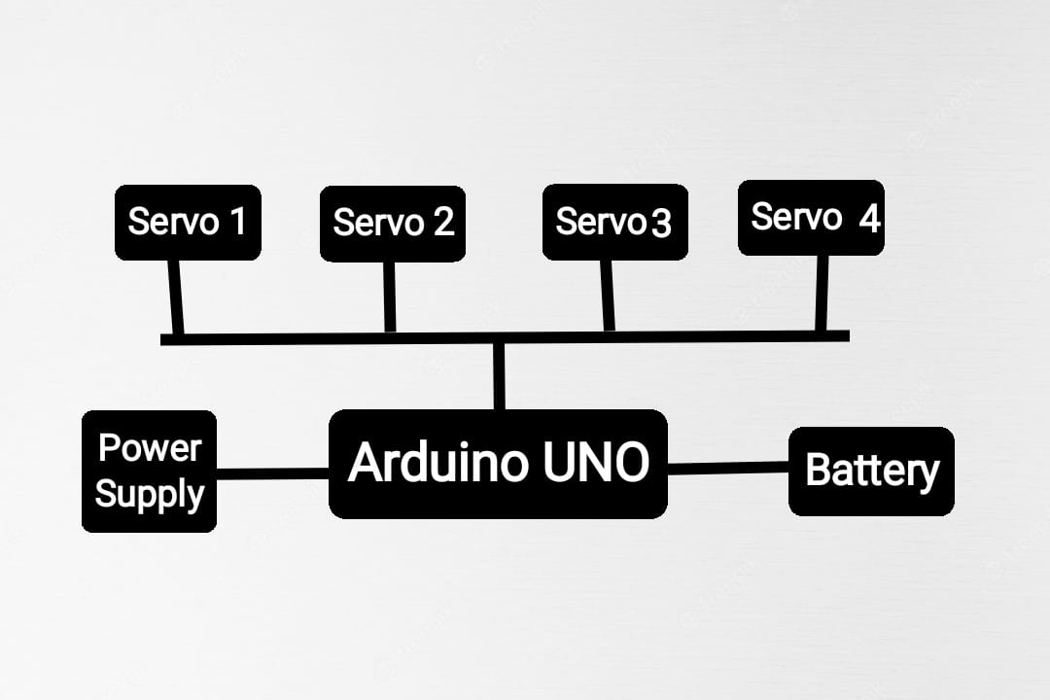
Block Diagram

Slide 10
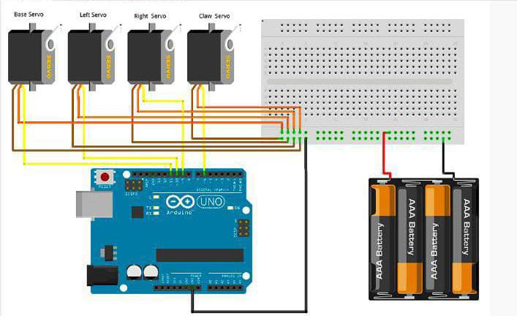
Methodology
Rig up the circuit as shown in figure :

Slide 11
Methodology
This mechanical structure is designed to feed a person automatically
Firstly the mechanical structure is constructed using wooden planks in different shape
using screw.
Then servo motor is attached to each joint in left,right,down and mouth of the mechanical
structure
All the 4 wires of servo motor is attached to battery and Arduino Digital pin
Then the USB cable is connected to the laptop.
Me com is the App used to control the Mechanical structure in different directions.

Slide 12
Arduino Code
#include <Servo.h>
Servo servo1;
Servo servo2;
Servo servo3;
Servo servo4;
int servo1Pos = 90;
int servo2Pos = 90;
int servo3Pos = 90;
int servo4Pos = 90;
char endOfPacketChar;//Data is sent via fixed lenght set of Integers, Terminated by a Char,
Example Packet: int1,int2,int3,int4,x

Slide 13
const char servoEOPC = 'x';
const int servoSpeed = 5;
void setup() {
servo1.attach(2);
servo2.attach(3);
servo3.attach(4);
servo4.attach(5);
Serial.begin(9600);
Serial.print("*** MeCon Robotic Arm Demo (4 SERVO) ***");
}
void loop() {
if (Serial.available() ) {
servo1Pos = Serial.parseInt();
servo2Pos = Serial.parseInt();
servo3Pos = Serial.parseInt();

Slide 14
servo4Pos = Serial.parseInt();
endOfPacketChar = Serial.read();
}
setServoPos(servo1,(180 - servo1Pos),servoSpeed,servoEOPC);
setServoPos(servo2,servo2Pos,servoSpeed,servoEOPC);
setServoPos(servo3,servo3Pos,servoSpeed,servoEOPC);
setServoPos(servo4,servo4Pos,servoSpeed,servoEOPC);
}
void setServoPos(Servo servoX,int targetPosition, int speedX, char servoEOPCX){
if (servoEOPCX != servoEOPC){
return;
}
if (servoX.read()==targetPosition){
return;

Slide 15
}
if (servoX.read() < targetPosition){
servoX.write(servoX.read()+1);
delay(speedX);
return;
}

Slide 16
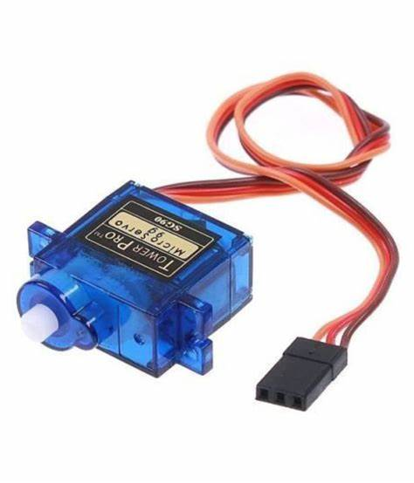
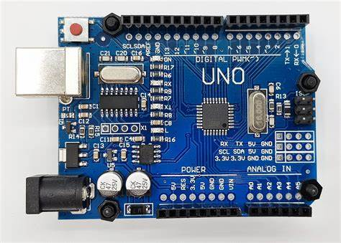
Hardware and software equipment
Servo motor:
The servo motor can have alternating current (AC), direct current (DC) or stepper motors.
They can operate steadily even at very small or very large speeds. In these motors, the large moment can be obtained from the small size.
Arduino:
The Arduino Uno is a type of Arduino board that is provided as an open-source board that uses an ATmega328p microcontroller in the board. The Arduino Uno contains a set of analog and digital pins that are input and output pins which are used to connect the board to other components. There are a total of fourteen I/O pins placed inboard in which six are analog input pins. The board has a USB connection that can be used to a power supply to the board.

Slide 17
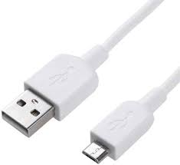
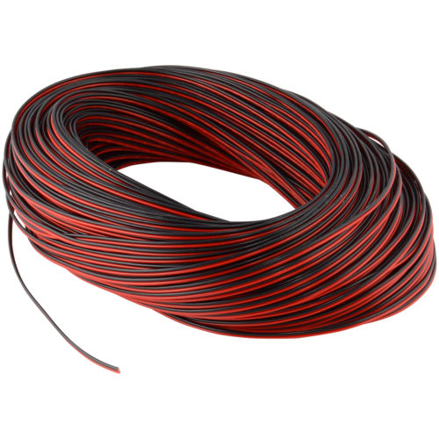
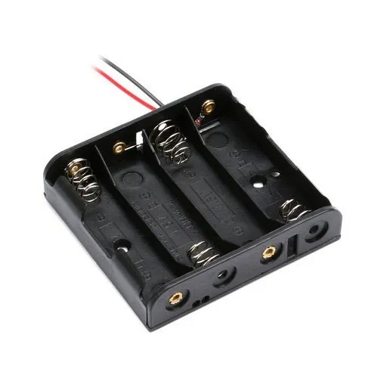
USB CABLE
RED-BLACK WIRES
BATTERY HOLDER

Slide 18
Expected result
Our project is an innovative idea of intelligent system which has basically line detection feature and will provide help in various fields like Industry sectors, service sectors and hospitals. The sensors In this system are a type of infrared sensor that senses the line and gives the feedback to the microcontroller unit.
1. The battery activates the circuit.
2. The sensor transmitter transmits the frequency, which reflects from the surface, Sensor receiver receives the reflected frequency and gives it to the microcontroller.
3. The microcontroller processes it and gives the signal to motor driver Lc .
4. Motor driver IC rotates the motors as per the signal receive and then the wheels rotate.

Slide 19
References
Hye-Jong Kim,Yuto Tanaka,Akihiro Kawamura,Sadao Kawamura and Yasutaka Nishioka, “Development of an inflatable robotic arm system controlled by a joystick”, IEEE Conference Publications, 2015,Pages: 664 – 669.
] D. Bassily, C. Georgoulas, J. Güttler, T. Linner, T. Bock, TU Munchen and Germany, “Intuitive and Adaptive Robotic Arm Manipulation Using the Leap Motion Controller”, Conference ISR ROBOTIK, 2014,Pages: 1 – 7.
. Gold, S., Rangarajan, A., Lu, C., Mjolsness, E.: New Algorithms for 2D and 3D Point Matching: Pose Estimation and Correspondence. Pattern Recognition 31, 957– 964 (1997).
Boucher, F. : From need to innovation [industrial activities]. IEEE Robotics Automation Magazine 22, no 3, 18–19 (2015).
HS Juang, KY Lurrr. Design and control of a two-wheel self-balancing robot using the Arduino microcontroller board. Control and Automation (ICCA), 2013
R Krishna, GS Bala, SS ASC, BBP Sarma. Design and implementation of a robotic arm based on haptic technology. Int. J. of Eng. Research. 2012.

